Slide 1
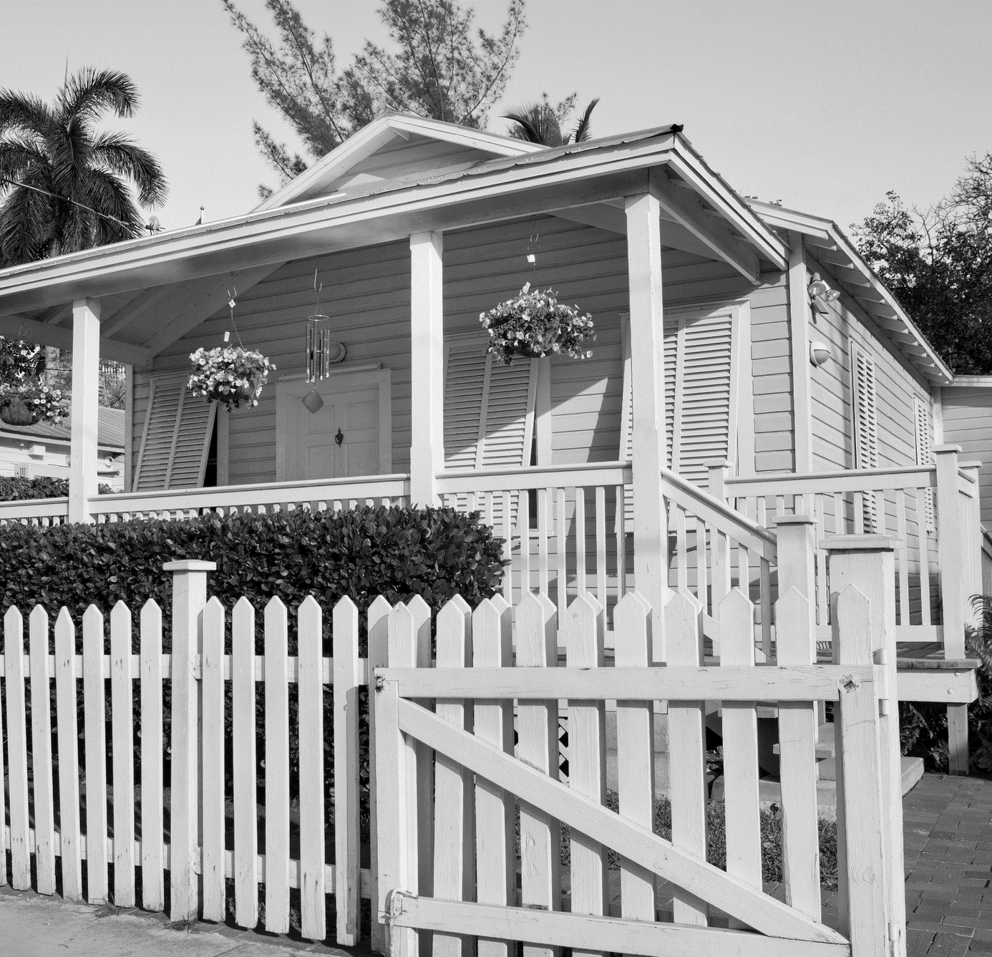

Permanent Affordability
NCDA Conference
June 15, 2023

Slide 2
Housing is…
Housing is Healthcare
Housing equals Jobs
Housing equals Opportunity
Housing is a human right

Slide 3
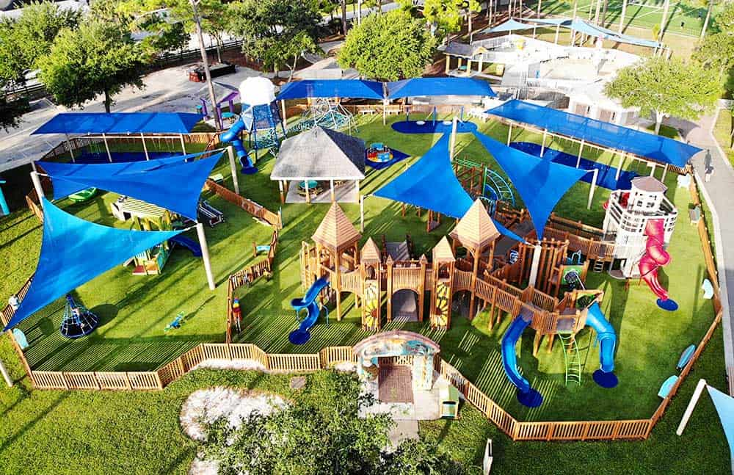
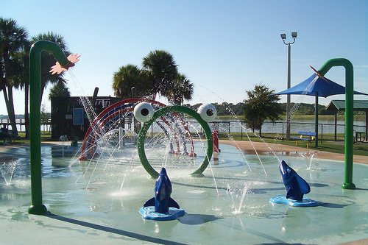
Infrastructure, Amenities and Assets
Photo Credit: Jacksonville Beach Moms https://www.jacksonvillebeachmoms.com/jacksonville-playground/
Photo Credit: My Area Network 727 Area https://www.727area.com/florida/st-petersburg/recreation/dell-holmes-park.htm

Slide 4
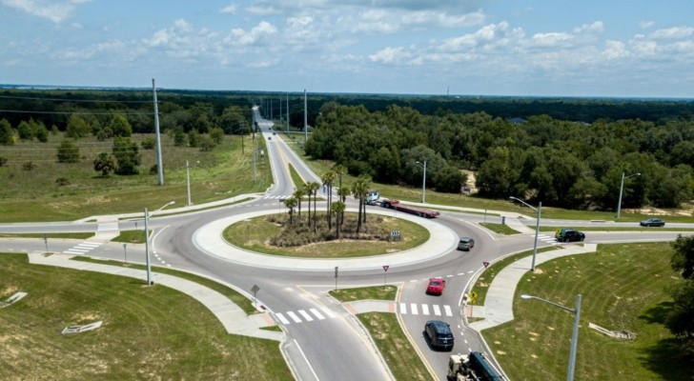
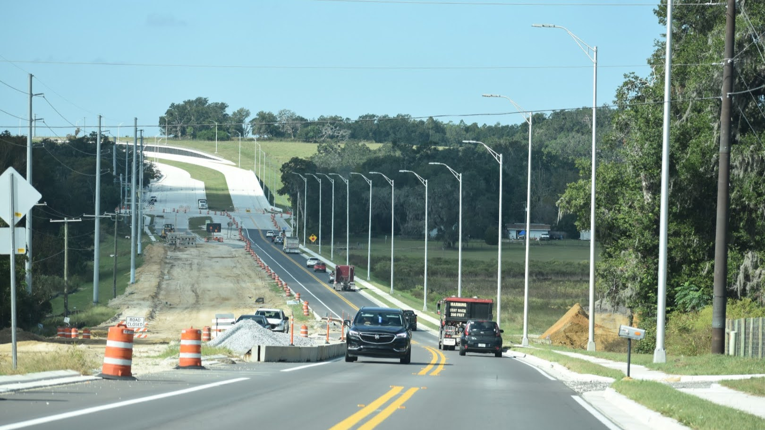
Infrastructure, Amenities and Assets
Photo Credit: FDOT https://www.cflroads.com/
Photo Credit: Tampa Bay Times https://www.tampabay.com/news/transportation/2023/02/17/highway-state-road-52-mirada-metro-development-group-traffic-bottleneck-san-antonio/

Slide 5
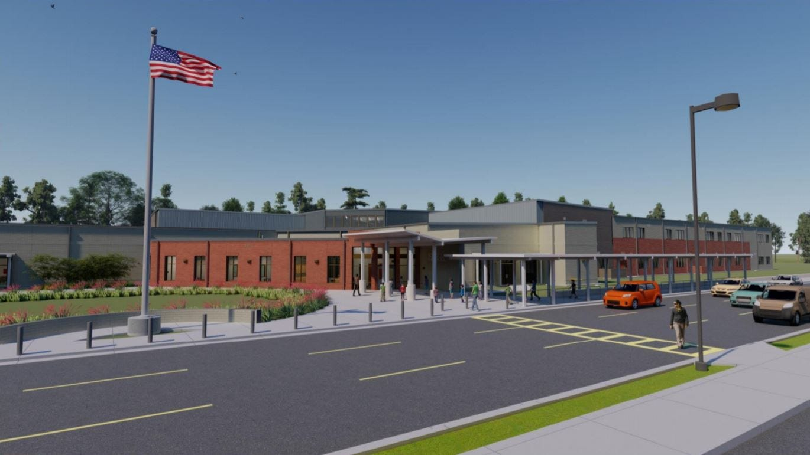
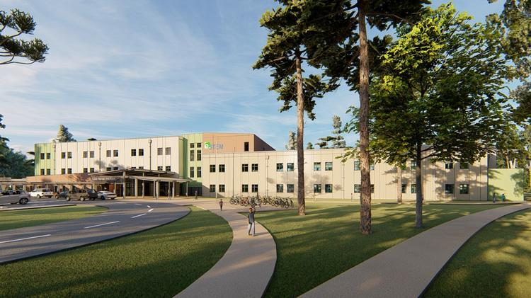
Infrastructure, Amenities, Assets
Photo Credit: WUWF https://www.wuwf.org/local-news/2021-10-12/new-santa-rosa-school-addresses-growth-in-pace
Photo Credit: Orlando Business Journal https://www.bizjournals.com/orlando/news/2019/10/03/new-33m-c-fla-school-adds-to-areas-lateststem.html

Slide 6
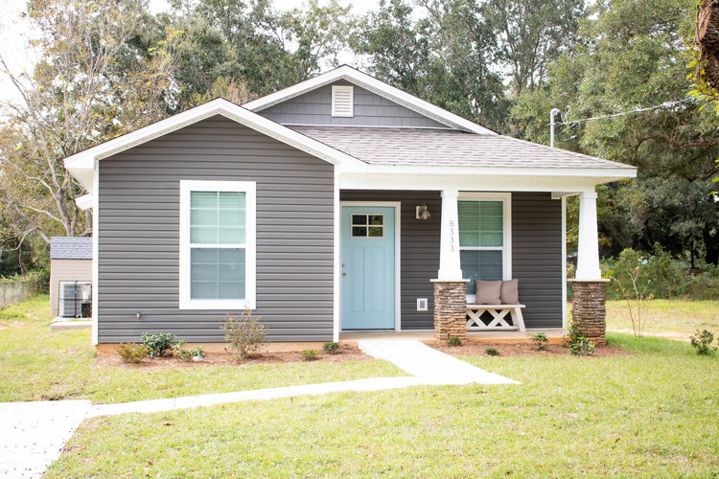
What about Housing?
Can affordable housing be “infrastructure”?
Is affordable housing a community asset?
Should affordable housing be a permanent community asset?
Source: Pensacola Habitat for Humanity 11/8/2022

Slide 7
The Need For Permanent Affordability and Strategies to Accomplish It

Slide 8
Affordability Periods Generally
An “affordability period” or “term of affordability” is a term used to describe the number of years a unit assisted by public resources must remain affordable.
“Long-term affordability” is generally considered 50 years or more.
Term of affordability may depend on:
  Total amount and type of resources provided
  Scarcity of resources
  Housing needs
  Market trends
  Public policy considerations

Slide 9
Typical Subsidized Purchase: Recapture Approach
Buyer identifies a suitable home at market price
Buyer receives purchase assistance to cover gap between market price and approved financing and buyers own down payment
Now, the homeowner, decides to sell in 7 to 10 years
Home is resold at market price
Homeowner, now seller, repays purchase assistance, any remaining amount of mortgage and transaction costs, and takes the rest as profit
Home, in most cases, is no longer affordable or requires a larger subsidy to be affordable to the next similarly-situated purchaser

Slide 10
Expiring Affordability in Rental Housing in Florida
In the 2020s, there is an expected increase in the loss of assisted housing due to expiring rent restrictions. Why? The 30-year affordability terms for the LIHTC deals in the early 1990s (before FHFC set a 50-year affordability period) are set to expire this decade as well as other 1970s-90s programs.
Between 2019 and 2022, the state lost 40 developments with 3,999 affordable units due to expired FHFC, HUD, and USDA Rural Development mortgages.
By 2032, an additional 250 developments with 24,639 affordable units face similar risks (almost 3,000 units are at risk in 2025 alone).
This information is found in the 2022 Rental Market Study produced by the Shimberg Center for Housing Studies for FHFC.

Slide 11
Why Permanent affordability?
Preserves affordable housing units.
Ensures multiple households are stably housed in the same assisted unit.
Retains and grows the value of public investments.
Conserves limited public resources through their most efficient use.
Builds communities by preventing displacement.

Slide 12
Removing Land from the Speculative Market
Land is a limited asset
Land is generally an appreciating asset
The value of land will grow as other investments are made
Landowner controls how the land is used

Slide 13
Program design to retain the subsidy
Uses mechanisms in legal documents to retain investment of resources in the housing unit
  Income eligibility of subsequent purchaser
  Limits on resale price
Can implement with all housing types
Creates permanent inventory of affordable housing available to the community

Slide 14
Ground Lease as Best Practice for both Removing Land from the Speculative Market and Subsidy Retention
Creates a clear relationship recognized by law
Active enforcement by the parties to the ground lease
Can better implement affordability requirements long-term

Slide 15



CLT Model for Retention
The vehicle of separating ownership of the land from the building
Captures public investment and retains it with the housing unit for permanent affordability using a ground lease
Also, nonprofit organization that holds title to the land, sells the home on the land, and administers the 99-year ground lease that keeps the home affordable for one family after the next.
Notes:
Alternative to renting
pros /cons

Slide 16
How Does it Work for Rental Development?
CLT owns the land
The Developer/Owner of improvements could be:
  For-profit
  Nonprofit
  The CLT
Ground lease provides permanent affordability in contrast to expiring LURA
CLT can provide compliance monitoring function for income eligibility of tenants and unit set-aside requirements
Notes:
CLT most likely serving in more of a compliance monitoring function than doing the income verifications as tenants move in

Slide 17
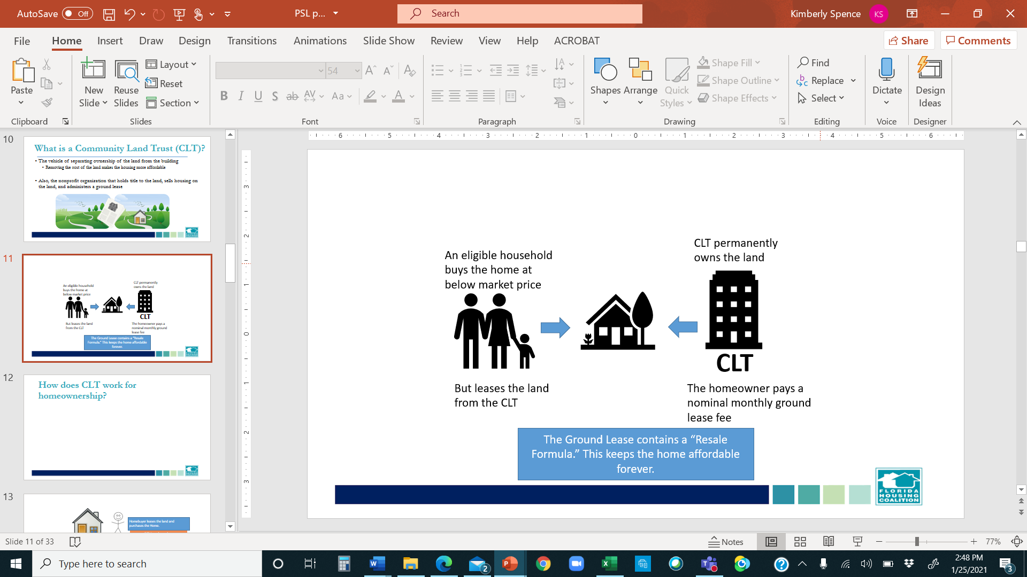
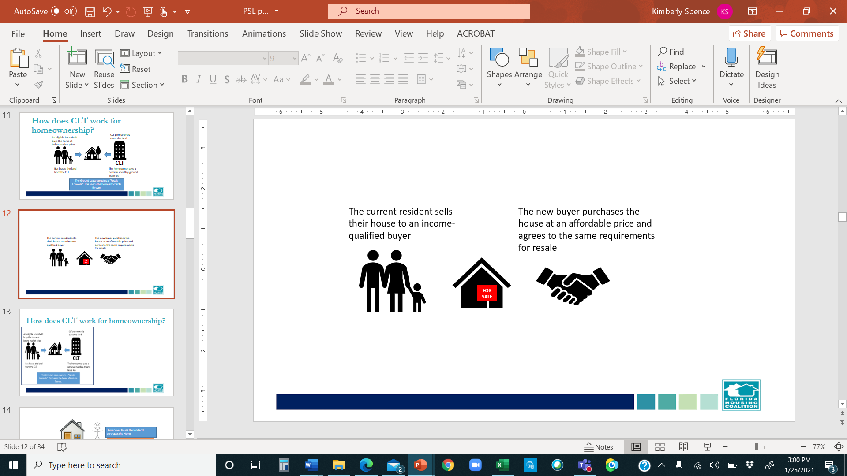
How does CLT work for homeownership?
Notes:
Ownership of the land is held by a nonprofit. The home is deeded together with a 99- year leasehold interest in the land to income eligible household

Slide 18

What about wealth building?
Financial stability
Ability to move up
Tapping into home equity for…
Ability to pass onto children or other heirs

Slide 19
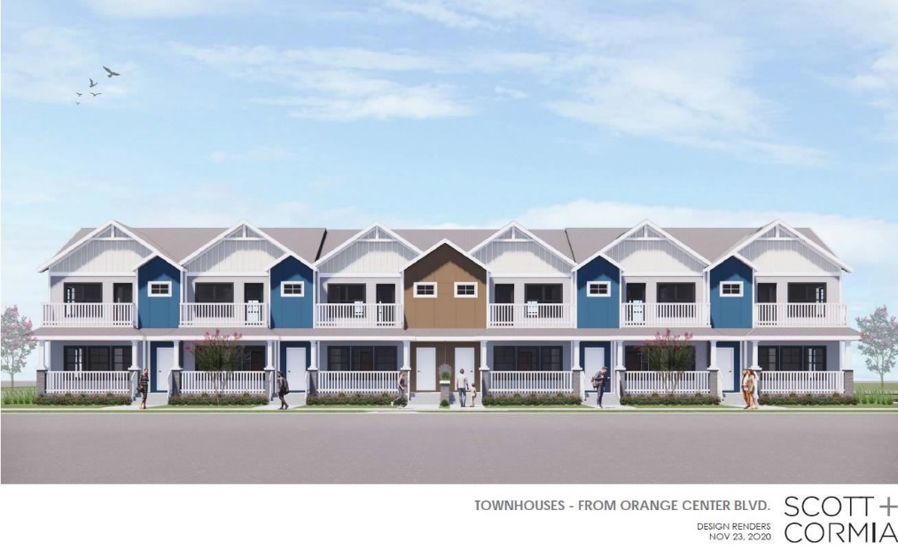
CLT v. Rental Example: Hannibal Square, 2019
 | CLT Homebuyer | Apartment Renter
Housing Size | 3BR/2BA | 2BR/2BA
Home Price | $145,000 | --
Deposit/Down Pmt—Out of Pocket | $5,000 | $4,200
Monthly Payment | $902 | $1,400
Total Paid (Mortgage/Rent) in 10 yrs | $108,240 | $168,000
Property Value After 10 Years | $253,495 | 0
Payout After 10 Years
Mortgage Equity | $22,795
Equity from Appreciation | $27,124
 | $49,919 | $1,400
Source: Hannibal Square CLT, 2019; utilizing compounded appraisal-based resale formula with 25% appreciation share to homeowner

Slide 20
Lending for CLT Purchases
Major advantages to CLT loans :
  Extremely low foreclosure rate
  CLT’s right of repurchase
The stewardship role provides additional assurance of success for the homeowner
Simplified process with Freddie Mac and Fannie Mae to allow CLT homebuyers to benefit from their products
  Freddie Mac information – HERE
  Fannie Mae information – HERE
Education still needed at the market level

Slide 21
Permanent Affordability in Florida

Slide 23
Live Local Act and Ground Leases
Provides mandatory real estate tax exemption on land owned by a nonprofit
Establishes that ground leasing is an acceptable means for utilizing publicly-owned land for affordable housing
Generally establishing ground leasing as a best practice for long-term affordability

Slide 24
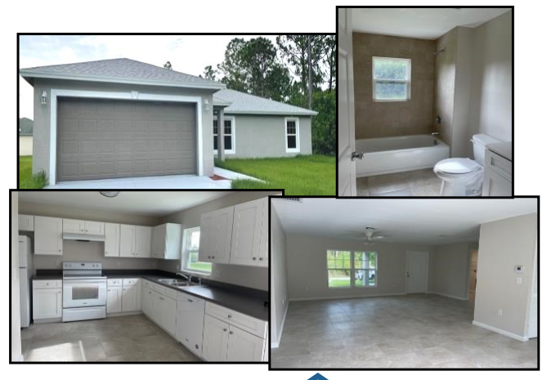
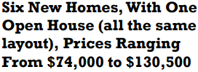

Surplus Land Example: Port St. Lucie
Government-owned lots
NSP funds for construction
Homes to be sold by community land trust
CLT takes title to the land
Resale restrictions in ground lease keep homes permanently affordable
Local government investment retained forever in the homes
Source: CLT of PBC and TC https://cltofpbc.org/wp-content/uploads/2021/12/cltpbc-Open-House-flyer.pdf

Slide 25

Redevelopment Example: Delray Beach
CLT established as proactive measure mitigate future pressure on housing prices and preserve public investment in CRA neighborhoods
Partnerships – Startup and ongoing
  City of Delray Beach (land donations, in-kind donations, SHIP funds)
  Delray Beach CRA (startup funding, ongoing operational funding, land donations, acquisition and construction loans, purchase assistance)
100+ homeownership units in the CLT; also manages 37 rental units owned by the CRA
Flyer for latest Delray Beach CLT development (Source: DBCLT)

Slide 26
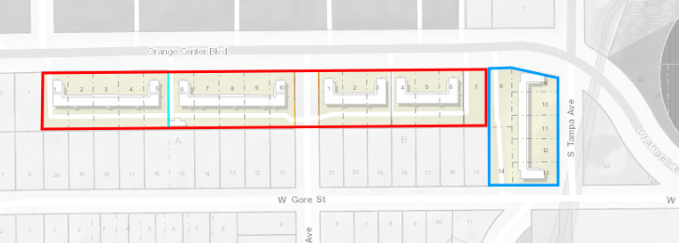

Redevelopment Example: Hannibal Square
Established in 2004 to preserve affordability in Winter Park
Prompted by desire to preserve African-American identity and heritage of Hannibal Square neighborhood
Location where land values can exceed value of homes
Approximately 30 units in Hannibal Square community
Recently expanded geography to serve surrounding communities
Site plan and Elevation for Orange Center development in partnership with City of Orlando, will include townhomes for sale, rental apartments and commercial space (Source: HSCLT)

Slide 27
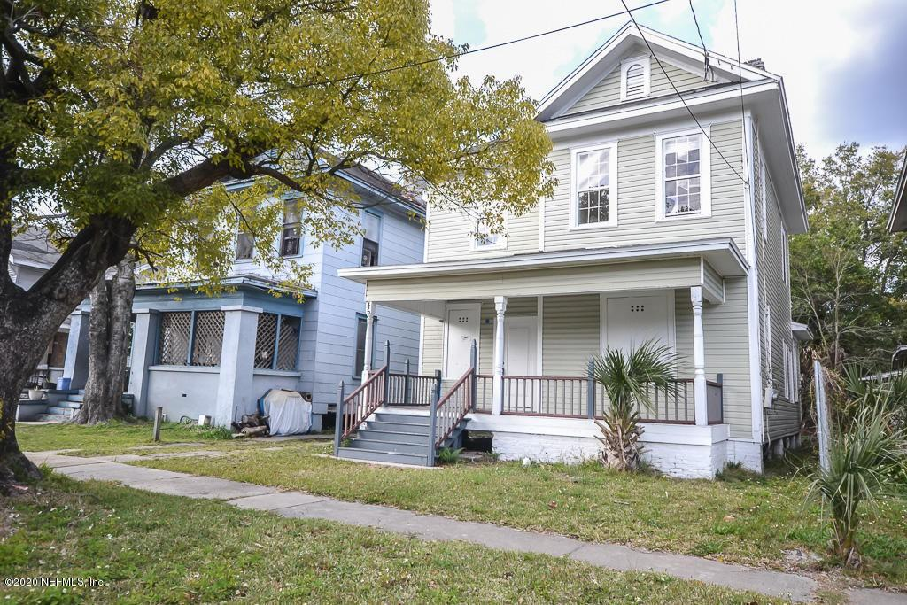

Neighborhood Stabilization Example:
Jacksonville
CLT to be primary stabilization strategy
City-owned lots to be redeveloped for homeownership opportunities in partnership with CDCs and other builders
CLT to coordinate disposition and handle ongoing stewardship
Home for sale in northern Springfield neighborhood in Jacksonville, previously disinvested and now on the rise (source: Realtor.com)

Slide 28

Inclusionary Zoning Example: Jupiter
Requires 6% of all developments of 10 units or more as Workforce Housing units
For-sale units must remain affordable in perpetuity
Ordinance calls for contract with Community Land Trust for program administration

Slide 29
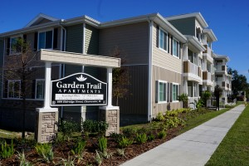


Permanently Affordable Rental Housing as Part of Community Infrastructure
Infrastructure surtax funds can be used for land acquisition for affordable housing (Refer to Florida Statutes Section 212.055(2)(d)(1)(e))
Resource can be provided through a ground lease program that maintains affordability in perpetuity
Examples:
  Pinellas County: over 600 permanently affordable rental units
  Collier County: currently working to develop rental units
Garden Trail Apartments in Clearwater is funded by Pinellas County’s Land Assembly Program and will remain affordable in perpetuity. Source: http://pinellascounty.org/hfa/
Notes:
“Any land acquisition expenditure for a residential housing project in which at least 30 percent of the units are affordable to individuals or families whose total annual household income does not exceed 120 percent of the area median income adjusted for household size, if the land is owned by a local government or by a special district that enters into a written agreement with the local government to provide such housing. The local government or special district may enter into a ground lease with a public or private person or entity for nominal or other consideration for the construction of the residential housing project on land acquired pursuant to this sub-subparagraph.”

Slide 30
CLT Resources – Florida Examples

Slide 31
CLT Training and Certification Program
Training to build capacity in CLTs based on standards and best practices
Technical assistance and peer learning
Organizational Self-Assessment to determine CLTs ability to:
  carry out stewardship responsibilities
  Minimize risks of default
  Meet GSE requirements
Review of operations by Florida Housing Coalition
Certification recognized by Freddie Mac
CLT Best Practices Manual: http://www.flhousing.org/wp-content/uploads/2021/08/8-30-FL-CLT-Best-Practices-FINAL.pdf

Slide 32
CLT Homebuyer Education
Model CLT Homebuyer Education Module helps counselors inform buyers of the CLT option
Requires buyers to attest to understanding of CLT homeownership and resale formula prior to purchase
Teacher’s and Homebuyer’s Editions downloadable at: https://flhousing.org/community-land-trusts/

Slide 33
Purchase Assistance Strategies
Model CLT Add-On Language for SHIP Purchase Assistance Strategies
Federal Funding strategies
  Establish NRSA with CLT as a CBDO
  Stewardship activities of CLT as a public service
  Resale approach with HOME funds
Make all sources of purchase assistance assumable, if possible

Slide 34
Planning for Permanent Affordability

Slide 35
Planning for Permanent Affordability
Underwriting developments with permanent affordability in mind
Initial funding – may require higher investment up front to ensure permanent affordability
Asset and property management
  Long-term upkeep of structure
  Prioritizing preservation funding and other local incentives for permanently affordable housing
  Provision of services to meet other needs and long-term community goals
    Childcare
    Healthcare
    Job training
    Preparing for homeownership (rental → CLT homeownership → market homeownership)

Slide 36
Expiring affordability – study locally funded developments
Now is an opportune for local government to study its own assisted affordable housing inventory and identify how many units are at risk of expiring.
Look at projects funded by HOME, CDBG, etc. at the local level.
What is the status of local projects with affordability periods that have already expired? Are they still affordable or have they converted to market rate?
This data could help you set longer terms of the affordability or otherwise improve policies moving forward.

Slide 37
Questions/Discussion

Slide 38

Thank you!
Ashon Nesbitt
Chief Executive Officer
nesbitt@flhousing.org
813-476-4170

